Slide 1
OPERATION ARCTIC CITADEL (OPAC)
Introduction Brief
CAO: 2025-01-06
Version: 0.2
Notes:
Changes:
1.1: Minor updates to correct the brief IAW actual situation.

Slide 2
AGENDA
What is the OP Arctic Citadel Campaign
Actors
Situation / Road to war
Military start point
Admin
Functions/Roles
Products
Generic timeline
Information flow/ Where to find information

Slide 3
OPAC CAMPAIGN
Realistic but not real
Player driven
Volunteers plan and conduct the air campaign
Volunteers support with analysis of reported information and intelligence
Player reporting and actions have short and long-term effects of outcome of campaign
Tacview is off
Everyone encouraged to avoid looking in the .miz, track files or tacview with red information
Blue tacview will be available (realistic)
Intelligence reporting
Campaign Manager
Documentation
A lot to read (Do not need to read everything)
Needed to facilitate a realistic, player driven campaign

Slide 4
ACTORS - Allied
Norway
Norway have granted overflight and movement rights for allied forces in support of Finland.
Norway are supporting with military aid, and the flow of goods to Finland.
Norway have allowed bases to be used for operations toward Notia or Kambiland without restrictions ( Bodø, Andøya, Bardufoss and Banak).
Finland
Finland is the country that have asked for support from allies.
Finland are hosting CJTF-23 operations from all bases and infrastructure.
Sweden
Sweden have granted overflight and movement rights for allied forces in support of Finland.
Sweden are supporting with military aid, and the flow of goods to Finland.
Sweden have not allowed Swedish bases to be used for operations toward Notia or Kambiland

Slide 5


ACTORS - Adversaries
Notia
Notia is a vast, iron-fisted state reminiscent of the Soviet Union at the height of the Cold War. Governed by a single-party regime, power is centralized in the Supreme Council, presided over by a stern Premier who controls nearly every aspect of civilian and military life. The nation’s sprawling industrial complexes churn out tanks, aircraft, and propaganda alike, reinforcing a massive military apparatus. Despite the strict internal security imposed by the secret police, Notia’s people hold onto a sense of collective pride in their shared heritage and technological achievements. This mix of authoritarian control and fierce national identity makes Notia a formidable force on the global stage.
Kambiland
Kambiland is the “little brother” to Notia, forged from the cultural tapestry of shared bond of hardness. An authoritarian regime led by a formidable Supreme Leader wields near-total power, upheld by a sprawling security apparatus that cracks down on any hint of dissent. Despite longstanding economic challenges, vast natural resources and fervent nationalism fuel Kambiland’s aspirations. Its strategic alliance with Notia serves to bolster both nations’ military and political leverage, reflecting a bond that balances regional dominance with cultural ties. While a powerful state in its own right, Kambiland’s identity and future remain closely linked to the ambitions of its elder ally
Enemy: is actively opposed or hostile to CJTF and friendly forces.
Adversary: opponent in a contest, conflict, or dispute toward CJTF and friendly forces.
Neutral: not supporting or helping either side in a conflict, disagreement, etc.; impartial.

Slide 6


ACTORS - Adversaries
Democratic Union of Socialist States (DUSS)
Xilong, Notia and Kambiland are allied as part of DUSS.
Xilong
Xilong are the lead nation of DUSS and are projecting power worldwide using air and maritime assets.
Enemy: is actively opposed or hostile to CJTF and friendly forces.
Adversary: opponent in a contest, conflict, or dispute toward CJTF and friendly forces.
Neutral: not supporting or helping either side in a conflict, disagreement, etc.; impartial.

Slide 7
ACTORS - Adversaries
The Iron Resolve
Terror group in support of Notia.
Close ties to Notia special forces.
The Dawn’s Vengance
Terror group in support of Kamibland.
Close ties to Kambiland special forces.
Enemy: is actively opposed or hostile to CJTF and friendly forces.
Adversary: opponent in a contest, conflict, or dispute toward CJTF and friendly forces.
Neutral: not supporting or helping either side in a conflict, disagreement, etc.; impartial.
Notes:
Notia – The Iron Resolve The Iron Resolve is a clandestine group operating along the northern frontier of Notia, driven by an unyielding commitment to reclaim the territory they believe was unjustly seized by Finland. They work covertly, engaging in calculated acts of sabotage and forming alliances with sympathetic factions determined to see the disputed lands returned. Though they often present themselves as patriotic liberators, their methods can be ruthless—targeting key border infrastructure and pressuring the Finnish authorities through a mix of propaganda and high-stakes incursions. The organization is led by the formidable General Boris Ulyanov, a rumored veteran of foreign conflicts whose tactical prowess has proven instrumental in keeping the Iron Resolve’s ambitions alive.
Kambiland – The Dawn’s Vengeance Emerging from Kambiland’s mountainous border regions, The Dawn’s Vengeance wages a relentless campaign to restore the territory they claim was taken by Finland generations ago. Drawing support from local tribes and nationalist movements, they orchestrate daring cross-border raids designed to destabilize Finnish control over the contested area. Although they portray themselves as freedom fighters for Kambiland’s sovereignty, their activities occasionally draw international condemnation for their willingness to use violent tactics. At the helm of The Dawn’s Vengeance is the enigmatic Comrade Vladislav Makarov, a figure admired by his followers for his fervent speeches on national unity and feared by opponents for his uncompromising stance on territorial reclamation.

Slide 8

Xilong, XIL
Translation: "Western Dragon"
Government and Leadership
Government Type: Absolute technocratic oligarchy. Ruling Party: The Eternal Vanguard Collective (EVC).
Leader: Chancellor Jin-Tai Ren, a figure of legend whose ascension remains cloaked in mystery. The state propagates stories of him being chosen by the "Ancient Flame," a mythical source of Xilongese destiny, further embedding his near-messianic image.
The Eternal Vanguard governs with precision, guided by a council of technocrats and generals. Decisions are shaped not only by human judgment but by a sophisticated AI called the "Iron Vision," which aids in military and policy planning, symbolizing Xilong’s technological supremacy.
Capital: Longhua Citadel
A monolithic city located atop a vast plateau, combining ancient stone-carved temples with skyscrapers that pierce the heavens. It reflects Xilong’s philosophy of blending tradition with the future, embodying their drive for perpetual evolution.
Cultural Identity
Xilong celebrates a blend of its mythic past and scientific achievements. Society is driven by the motto: “Forge the Present, Conquer the Future.”
A state religion, The Doctrine of the Eternal Flame, binds citizens to the belief that their destiny is preordained by cosmic forces. This, paired with state-driven education and media, cements loyalty and reinforces the notion that Xilong is humanity’s inevitable guide to unity and progress.
Economy
Xilong’s economy, known as the Flame Engine Model, is centralized and fueled by a synthesis of advanced automation, state-sponsored megaprojects, and resource extraction from vast allied and tributary networks. Their flagship initiative, The Starfire Trade Route, spans continents, granting Xilong political leverage by linking global economies under their infrastructure.
Military Philosophy: The military is not merely an instrument of defense but a living embodiment of the nation’s will. Soldiers, referred to as the Sons and Daughters of the Flame, are celebrated as paragons of Xilongese virtue.
Iron Lotus Doctrine
The Iron Lotus Doctrine governs Xilong’s military strategies, emphasizing swift, overwhelming force combined with psychological and technological dominance. Its three core tenets are:
Bloom of Power: Utilizing concentric waves of deployment, Xilong’s forces are designed to spread like a blossoming lotus, enveloping and isolating key enemy positions. This principle is inspired by their ancient symbol of the lotus, which represents resilience and beauty in adversity.
Rooted Resilience: Xilong maintains a series of heavily fortified bases, interconnected by underground transport networks, enabling rapid reinforcement. These “Lotus Roots” ensure long-term survivability even under siege, discouraging prolonged conflicts against them.
Petal Strike: The doctrine champions the use of cutting-edge air and naval forces for precision attacks. Cyber-warfare units, equipped with quantum computing capabilities, destabilize enemy communications and infrastructure prior to any kinetic engagements. The mantra of the Petal Strike is "Sever the Stalk, Scatter the Leaves," referring to the surgical neutralization of leadership and command structures.
Key Military Assets
Celestial Guard: A fleet of modular drones capable of adapting to different combat roles, from reconnaissance to tactical bombing.
Iron Flame Armada: A naval fleet centered around the Leviathan-Class Supercarriers, equipped with railguns, hypersonic missile arrays, and submersible fighter craft.
Crimson Horizon Corps: Elite paratrooper regiments deployed for lightning-fast territorial grabs and urban warfare.
Ebon Eye Cyber Division: Specialists in cyber-sabotage and electronic warfare, capable of crippling adversaries’ defenses remotely.
Foreign Policy
Xilong views its role in the DUSS alliance as the "Architect of Unity," claiming to offer a vision of order against what it portrays as a fractured and self-serving global system. It uses the DUSS framework to maintain dominance over smaller allies like Notia and Kambiland, employing soft power and military backing to consolidate control.
Flag Analysis: The national flag reflects Xilong’s ideology and military precision. The white star symbolizes the eternal guiding force of the Eternal Vanguard. The eye at its center, known as the “Omniscient Flame,” represents their reliance on surveillance, intelligence, and strategic foresight. Encased within a blue circle of unity and bordered by a black ring of resilience, the star and eye rest on a red field, signifying the shared sacrifices of the Xilongese people.

Slide 9
Democratic Union of Socialist States (DUSS)
Motto: “Strength in Unity, Power in Purpose”
Flag Description: The DUSS flag embodies the alliance’s aggressive unity and revolutionary zeal.
Upper Half: A menacing golden skull with cephalopod-like tendrils, symbolizing domination and resilience, set against a crimson backdrop representing struggle and sacrifice.
Lower Half: A crimson trident piercing upward from a golden field, signifying the alliance’s offensive capabilities and three-pronged strategy of military, economic, and ideological dominance.
Overview
The Democratic Union of Socialist States (DUSS) is a formidable geopolitical alliance forged on shared ideologies of centralized power, socialist governance, and resistance to perceived Western hegemony. Led by the militaristic and technologically advanced Xilong, DUSS is a collective of authoritarian regimes unified under the promise of mutual defense, economic cooperation, and cultural synchronization.
Key Members:
Xilong (Leader Nation)
Notia (The Iron Bastion)
Kambiland (The Younger Ally)
Supporting Members:
Syria, Iran, and Libya (Affiliated states providing logistical and political support but lacking full membership status).
Formation and Purpose
Founded amidst growing tensions between global blocs, the DUSS alliance emerged as a counterbalance to the influence of Western democratic coalitions such as NATO. Initially a loose agreement for mutual defense, the alliance solidified following a series of economic and territorial skirmishes in contested regions.
The DUSS seeks to expand its influence through:
Strategic Defense: Ensuring the territorial integrity of member states and protecting their interests abroad.
Economic Sovereignty: Establishing an interconnected network of trade routes and technological innovation to reduce reliance on Western economies.
Cultural Dominance: Promoting a unified vision of "progressive socialism," portrayed as the natural evolution of governance for a fractured world.
Doctrine of Unity and Resistance
The DUSS doctrine revolves around three core principles:
Mutual Defense: Any attack on a DUSS member is considered an attack on the entire alliance, invoking an immediate collective military response.
Unified Command: A centralized military and political council, the Supreme Directorate, oversees alliance-wide strategy. While led by Xilong, member states retain limited autonomy in their internal affairs.
Asymmetric Aggression: The alliance employs both traditional military strength and unconventional methods, such as proxy wars, cyber campaigns, and economic subversion, to destabilize opponents.
Member Contributions
Xilong (Leader Nation)
Provides cutting-edge technology, cyber capabilities, and advanced weaponry to other members.
Spearheads the alliance’s diplomatic and military strategies through its Iron Vision AI and extensive intelligence apparatus.
Notia (The Iron Bastion)
Known for its heavy industrial base and vast military manpower.
Specializes in ground-based offensive campaigns, often serving as the "shock troops" of the alliance.
Kambiland (The Younger Ally)
A resource-rich yet economically dependent state.
Focuses on supporting roles such as logistics, resource extraction, and localized conflicts that further DUSS’s goals.
Military Structure
DUSS operates under a unified military doctrine, emphasizing interoperability and collective force projection. Key units include:
The Crimson Tridents: Elite special forces trained for rapid deployment in contested zones.
The Golden Armada: A naval task force designed to secure strategic waterways and project power into distant territories.
The Cyber Tides: A coalition of cyber-warfare experts specializing in infrastructure disruption and intelligence gathering.
Ideological Vision
The DUSS portrays itself as the "future of humanity," opposing the corruption and decadence of liberal democracies. Through propaganda and cultural export, the alliance seeks to inspire global movements toward centralized governance, collective identity, and technological integration. Member states promote the idea that the DUSS alliance is the harbinger of a new global order—one where unity supersedes individualism and strength dictates destiny.

Slide 10
NOTIA (Socialist Republic of Notia - SRN)
Overview
Notia, also known as the Socialist Republic of Notia (SRN), is a militarized, authoritarian state located in the Arctic region, covering the Kola Peninsula and other northern territories. Governed by a rigid single-party system, Notia is a cornerstone of the DUSS alliance. Despite its relatively small population and geographic area, Notia wields significant regional power through its industrial capabilities, robust natural resource base, and unparalleled focus on air defense and military modernization.
Abbreviation: NOT
Government and Leadership
Government Type: Authoritarian single-party state under the National Socialist Vanguard Party. Leadership:
General Secretary Arkady Pokrovskii: Holds the dual role of President and Supreme Commander of the Armed Forces, embodying centralized control.
Council of Defense and Main Military Council: Key governing bodies overseeing military and economic mobilization.
The Notian regime thrives on totalitarian ideals, utilizing a robust propaganda network and the pervasive Directorate of National Security and Intelligence (DNSI) to enforce loyalty and suppress dissent.
Capital: Murmansk
Murmansk serves as Notia's administrative and military capital. It is a strategic hub for the Arctic fleet, resource exportation, and military research, housing multiple high-security military facilities.
Geography
Area: Approximately 144,000 square kilometers.
Climate: Subarctic, with extreme winters and rugged terrain.
Strategic Geography: The Kola Bay and the Barents Sea provide year-round naval access, making Notia a key player in Arctic militarization.
Economy
Notia's economy is heavily export-oriented, relying on natural resources such as:
Metals (Nickel, Titanium): 36% of GDP.
Electricity Exports: Hydroelectric and nuclear energy contribute 23% of GDP.
Fishing and Food Production: 13%, supporting both the domestic and naval food supply.
The economy is largely state-controlled, with a focus on sustaining the military-industrial complex. Advanced goods, machinery, and fuel are almost entirely imported, creating economic vulnerabilities.
Military
Philosophy
Notia’s military strategy is grounded in the principle of centralized control and overwhelming defense, particularly through its Integrated Air Defense System (IADS). The regime’s doctrine emphasizes deterrence, defensive resilience, and offensive projection when necessary.
Key Military Components
Notian Army
Heavily reliant on mechanized and armored units.
Strategic units such as SCUD missile regiments are prioritized for offensive and WMD deterrence roles.
Highly centralized command structure, making disruption of HQ facilities a critical vulnerability.
Notian Air Force and Air Defense
Renowned for its IADS, which integrates surface-to-air missiles (SAMs), AWACS, and radar systems to create one of the world's most formidable air defense networks.
Facilities like the Olenogorsk Air Defense Academy and various SAM production plants (SA-10, SA-11, SA-15) ensure self-reliance in defense production.
The Air Force is equipped with modern interceptors and strategic bombers, supported by advanced electronic warfare capabilities.
Notian Navy
Arctic fleet centered around Murmansk and Severomorsk, with a focus on surface fleet operations and submarine deterrence.
Strategic naval bases like Ostrovnoy Naval HQ and Polyarny Naval Base serve as critical hubs.
Weapons of Mass Destruction (WMD)
Notia maintains a robust WMD program, focusing on chemical and nuclear deterrence.
Facilities like the Severomorsk Chemical Weapon Production Facility and the Olenogorsk Uranium Enrichment Facility highlight its advanced capabilities.

Slide 11
NOTIA (Socialist Republic of Notia - SRN)
Notian Doctrine: The “Iron Shield”
Notia’s military operations are shaped by the Iron Shield Doctrine, which emphasizes:
Defense in Depth:
Layers of SAM systems protect key installations and cities, creating an impenetrable airspace.
A centralized IADS ensures that no individual air defense system acts alone, optimizing resource deployment.
Strategic Deterrence:
SCUD missile regiments equipped with WMDs serve as a deterrent against attacks.
Nuclear research facilities like the Koashva Research Facility are focal points for long-term strategic capabilities.
Command Centralization:
A hierarchical chain of command minimizes uncertainty but creates vulnerabilities to HQ attacks. Disruption of Corps or Supreme Command HQs can paralyze entire operations for up to 48 hours.
Hybrid Warfare:
Leveraging groups like Iron Resolve, Notia employs unconventional tactics, including sabotage, cyberattacks, and propaganda, to destabilize adversaries.
Cultural Identity
Notia’s culture revolves around themes of resilience, collectivism, and militarization. Propaganda emphasizes the people’s unity against external threats, fostering an "us versus them" mentality. Patriotic celebrations often include military parades showcasing the nation’s latest advancements in technology and weaponry.
Motto: “Strength Through Sacrifice”
Foreign Relations
As a central member of the DUSS alliance, Notia’s foreign policy is inherently tied to the bloc’s broader objectives. It serves as both a junior partner to Xilong and a mentor to Kambiland, acting as the main architect of the alliance’s Arctic strategies.
Flag Analysis: The flag of Notia prominently features socialist and martial symbols, embodying the regime's emphasis on strength, unity, and defense. The stark contrast of colors mirrors the harsh realities of its Arctic home, reflecting resilience and determination.

Slide 12
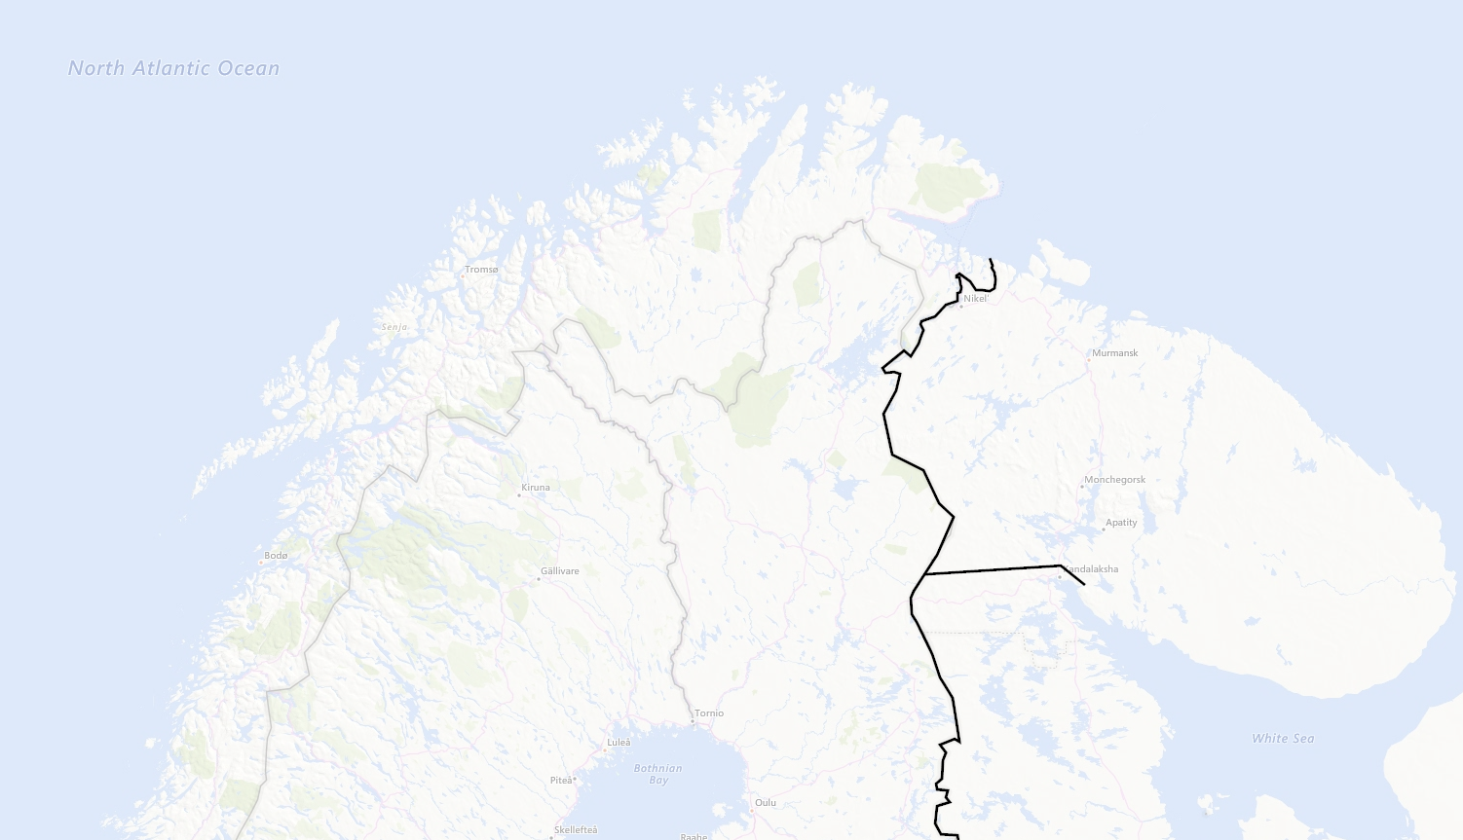
LOCATIONS
NORWAY
NOTIA
SWEDEN
FINLAND
KAMBILAND

Slide 13
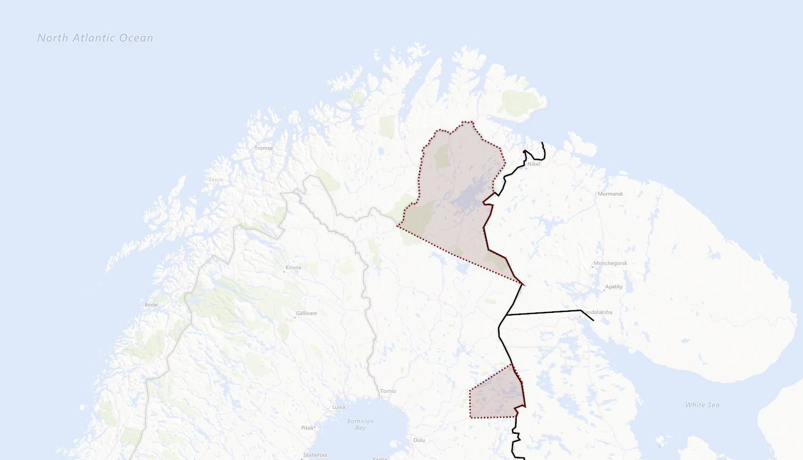


CONTESTED TERRITORY
Notian claims in Northern Finland
FINLAND
Kambiland settlements in Finland

Slide 14

SITUATION & TIMELINE (1 of 2)
Time at start of campaign: 20th September 2011 (D0)
Notia have over years claimed part of Northern Finland as part of Notia after WW2.
The last year Notia have increased their posture toward Finland and had public statement regarding protecting Notian nationals in Notian claimed territory in Northern Finland while also expressing offensive ambitions and need to create strategic depth and move defenses forward.
Notia have expressed concern about the Notian nationals living in Northern part of Finland and have urged UN to protect their rights.
Notia have expressed a willingness to intervene to protect Notian nationals everywhere in the world.
The last 3 weeks we have seen a buildup of military forces in Notia indicating higher activity than normal. Notia have stated that this is part of their national exercise FROST. The exercise is scheduled to last until 23rd of September 2011.
In the area of Kuusamo in Finland there are several settlements that have a majority of Kambiland inhabitants.
Kambiland have not an overt offensive posture in the same manner that Notia and have traditionally had good relations with Finland regarding the Kamibland nationals in Finland
Notian claims in Northern Finland
Kambiland settlements in Finland

Slide 15
SITUATION & TIMELINE (2 of 2)
Time at start of campaign: 20th September 2011 (D0)
Finland are feeling threatened and are assessing the situation as serious and that Notian plans to follow up threats and seize the Notian claims territory in Northern Finland before 2012.
Finland have asked for support from its close allies, and a close group of allies have created Combined Joint Task Force – 23 (CJTF 23) with both air, ground and naval units from different countries.
CJTF-23 aims to bolster Finnish defenses and deter and prevent an invasion from Notia.
CJTF-23 are tasked with creating contingency plans for attack on Notia to destroy Notian offensive capability if tasked by political authorities.
Notian claims in Northern Finland
Kambiland settlements in Finland

Slide 16
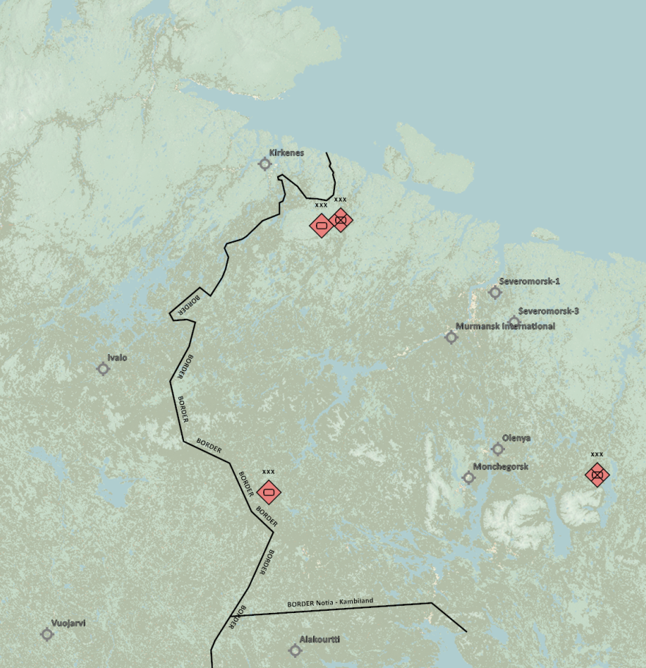
MILITARY SITUATION - ground
Notia ground force dispositions:
1st Corps have left bases and are in training area conducting exercise FROST.
2nd Corps have partially left base complex and are taking part in exercise FROST.
3rd Corps have left bases and are in training area conducting exercise FROST.
4th Corps are currently not mobilized and are at homebase.
Air Forces IAW INTREP VID OPAC-001 - Enemy Air Assets in Notia and Kambiland
Notian strategic IADS IAW: INTREP VID OPAC-002 - Notia IADS
NOTIAN and KAMBILAND Ground Combat Tactics – INTREP VID OPAC-003 DUSS Ground Combat Tactics
For details see intelligence page on OPAC briefing page.
Kambiland ground force disposition:
Kambiland forces are at home bases
2nd Corps
1st Corps
3rd Corps
4th Corps

Slide 17
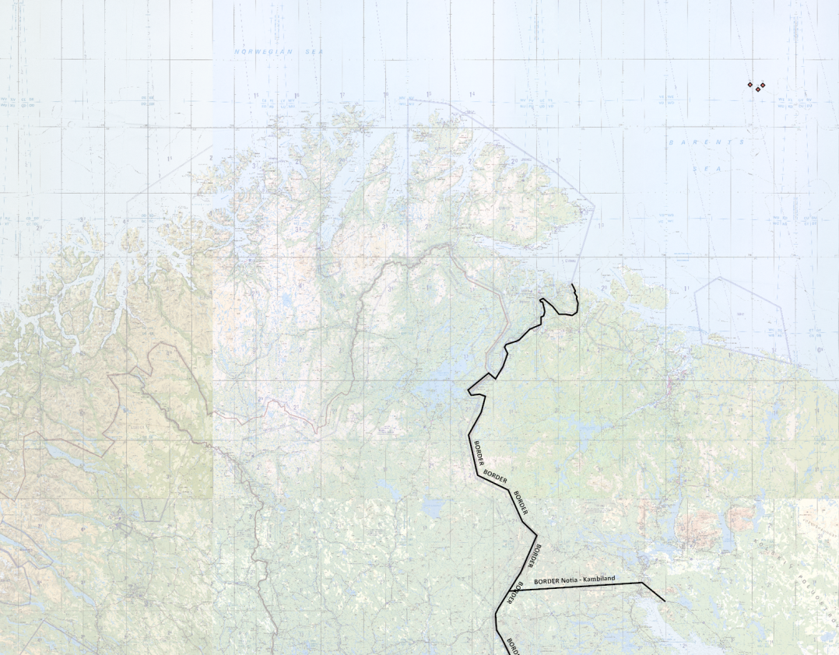
MILITARY SITUATION - maritime
Notia Navy dispositions:
Most of the Notian Navy are at home base, or in local waters
Earlier this morning (20th September, ATO Day 0), the Battle Cruiser Pyotr Velikiy and two Rezky class Frigates left port and are currenty about 130nm NORTH of the Kola Fjord. This is assessed as a SAG, and labeled the Pyotr Velikiy SAG.
Notian Navy IAW: INTREP VID OPAC-004 - Notian Navy
Pyotr Velikiy SAG

Slide 18
ADMIN

Slide 19
FUNCTIONS / ROLES
Combined Joint Task Force Headquarter (CJTF HQ): Mission maker/event host
Joint Force Air Component Commander (JFACC): Volunteer 132nd members/externals
Air Operations Centre (AOC): JFACC volunteers take turn
Virtual Intelligence Directorate (VID): Mission maker/event host
Virtual Intelligence Service (VIS): Volunteer 132nd members/externals
LCC Land Component Commander (LCC) – If interest, can be filled by volunteers (need minimum 3)
Maritime Component Commander (MCC) - If interest, can be filled by volunteers (need minimum 3)

Slide 20
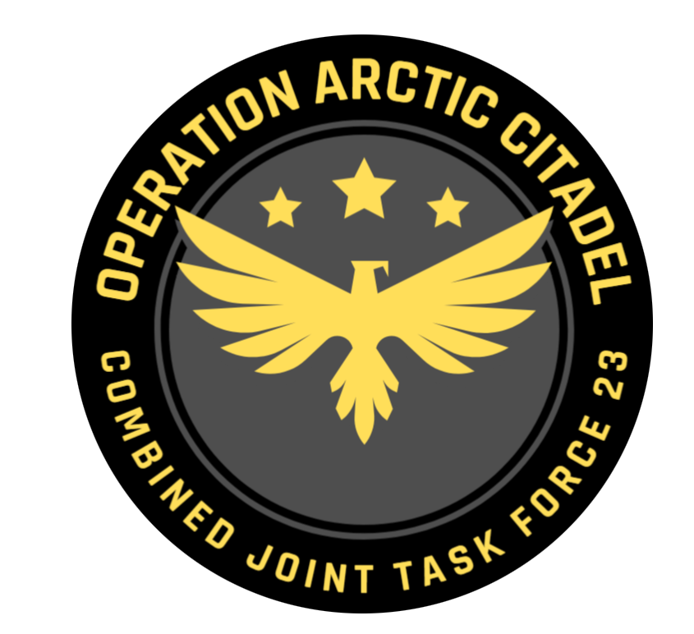
CJTF – 23 HQ
Commander of the entire force (Air, maritime and land forces)
Mission designer /event host
Ensures to streamline events
realism vs DCS limitations

Slide 21
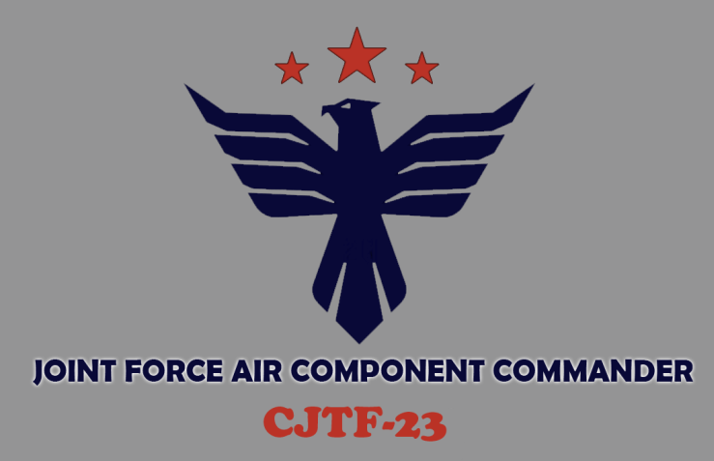
JFACC
Commander of Air Forces involved in the operation
Volunteer 132nd members
Takes guidance from CJTF-82 HQ, available intelligence, supported by VIS, to develop and execute the air campaign.
For details:
See JFACC Instructions (LINK)

Slide 22
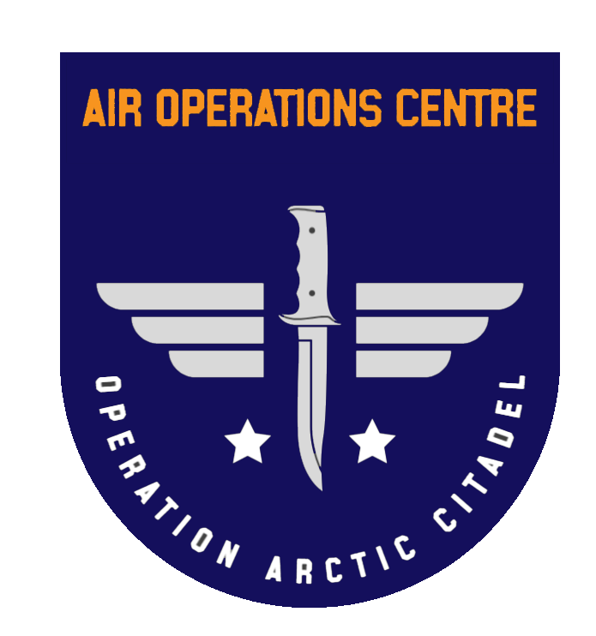
AOC
Translates JFACC daily guidance (Air Operations Directive, AOD) into a executable Air Tasking Order
One member from the JFACC team, responsible for the taskings for that specific event IAW JFACC guidance

Slide 23

VID
Higher echelon intelligence agency.
Mission designers /event host
A way for mission designers/event hosts to introduce intelligence into the scenario.
Reports will be forwarded to VIS

Slide 24

VIS
Intelligence agency that supports operations
Volunteer 132nd members
Most of the operation will be intelligence driven, and that intelligence will come from events.
For details:
See VIS Instructions (LINK)

Slide 25
VIS Cycle (Per ATO Day)
Targeting Cycle
Process raw intel
Plot locations on .cf
Update OOB
Update IR list
Update VIS Timeline
Analyse intel
Prepare new .cf summaries
Determine COAs
Update IR list
Targeting meeting planning
Decide target recommendations
Prepare presentation
Present intel
Ideally only once VIS know JFACC's plan
Produce any further deliverables that may be needed (e.g. .cf layers, extra info on particular targets)
Targeting Meeting
See TTP for rough agenda
VIS present first
JFACC present next
Discuss target priorities
Pilots fly mission and report intel
Should all be reported in Campaign Manager
Sometimes need to look at AARs as well
VID summary and JFC Guidance can also provide further info

Slide 26
GENERIC TIMELINE
Minimum 14 days between each ATO day (real world days)
Each ATO day is broken down into two events (DX.1 and DX.2. Time between DX.1 and DX.2 can be one week or more).
Day 1: Event D1.2, campaign day 1 (Sunday) (Last event of the previous ATO day)
Day 2: AARs and BDAs to be provided by pilots (Monday)
Day 3-8: VIS production and publish new INTSUM NLT Day 8 (Monday)
Day 8-12: JFACC guidance to AOC (publish new AOD, NLT Day 12, Friday) (supported by VIS throughout)
Day 12: AOC work day: Taskings/briefing/assignments (Friday)
Day 13+14: Pilots planning days
Day 14: Event D2.1, campaign day 2 (Sunday)
Day 21: Event D2.2, campaign day 2 (Sunday)

Slide 27
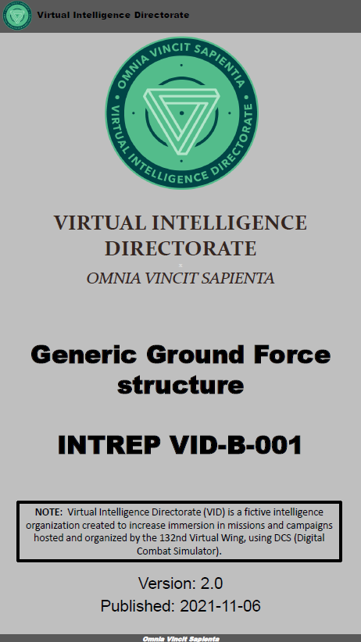
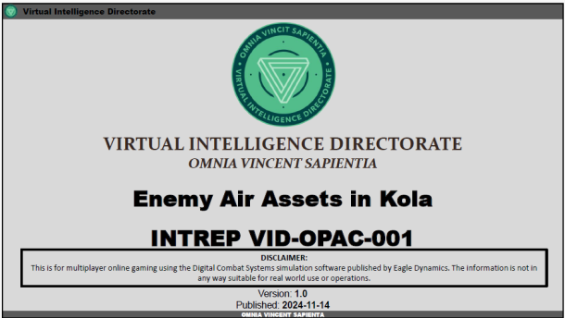
PRODUCTS
CJTF-23 Operation order (OPORDER)
JFACC Joint Air Operations Plan (JAOP)
SPINS (Special Instructions)
Airspace Control Plan
Air Operations Directive (AOD)
Airspace Control Order
Joint Target List (JTL)
Joint Prioritized Target List (JPTL)
Time Sensitive Target (TST) Matrix
Intelligence Report (INTREP)
Basic Intrep (Common to all 132nd events)
OPAC specific reports (Specific to OPAC only)
Intelligence Summary (INTSUM)
Per Event
Target Folder (TF)
Combatflite layers

Slide 28
PRODUCTS
Introduction brief
OPORDER
JTL
SPINS
INTREP X
JAOP
INTREP Y
INTREP Z
CAMPAIGN DOCUMENTS
PER EVENT
INTSUM
JPTL /TST
AOD
ATO/EXECUTION

Slide 29
PRODUCTS - campaign
Introduction brief
OPORDER: Operations Order
JTL: Joint Target List
JAOP: Joint Air Operations Plan
ACP: Airspace Control Plan
SPINS: Special Instructions
INTREP: Intelligence Report
OPORDER
JTL
SPINS
INTREP X
JAOP/ACP
INTREP Y
INTREP Z
CAMPAIGN DOCUMENTS
PER EVENT
INTSUM
JPTL /TST
AOD
ATO/EXECUTION

Slide 30
PRODUCTS – per event
Introduction brief
JPTL: Joint Prioritized Target List
TST: Time Sensitive Targets
AOD: Air Operations Directive
ACO: Airspace Control Order
ATO: Air Tasking Order
INTSUM: Intelligence Summary
OPORDER
JTL
SPINS
INTREP X
JAOP/ACP
INTREP Y
INTREP Z
CAMPAIGN DOCUMENTS
PER EVENT
INTSUM
JPTL /TST
AOD/ACO
ATO/EXECUTION

Slide 31
PRODUCTS - Pilots/controllers
JPTL: Joint Prioritized Target List
TST: Time Sensitive Targets
AOD: Air Operations Directive
ACO: Airspace Control Order
ATO: Air Tasking Order
INTSUM: Intelligence Summary
INTSUM
AOD/ACO
JPTL /TST
SPINS
Tasking
Execution

Slide 32
INFORMATION FLOW
132nd Website
Taskings / ATO
AAR
OPAC Briefing page
Discord OPAC section: (OPAC tag given to participants for access, both 132nd and externals)
JFACC: JFACC internal channel for work related to AOD and JAOP revisions
VIS: VIS internal channel for work related to INTREP and INTSUMs
JFACC-VIS: Internal coordination channel between JFACC and VIS for JTL and JPTL. Only for VIS and JFACC.
RFI: Channel for everyone to request “official” information
Products: Channel for everyone where CJTF HQ, AOC or VID publish information (Mission makers(event hosts) (will also be made available on the OPAC briefing page)
Media: Channel for everyone where media reports may appear.
BDA/Reports: Channel for everyone where pilots report BDA and other reports relevant for VIS to produce INTSUM/INTREPs
Event planning: Channel for everyone where information for the next event can be coordinated and discussed.
OPAC coordination: Chanel for everyone where coordination can be done. Anything not suited for other discord channels

